Slide 1




A predictive approach to Reducing Non Attenance
Transforming Outpatient care through data
Peter Andrews - Nov 2025

Slide 2
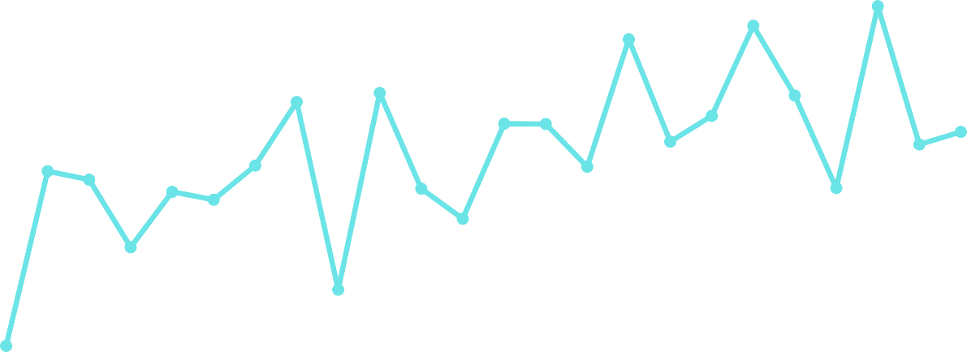
THE SITUATION
18 k M issed
Appointm ents Each M onth
12% of all hospital appointments are not attended by patients. This has consistently been the case since 2020.
24
1
22
20
DNAs (k)
18
2
£ 30
M illion
Per year. The cost of providing the outpatient appointments that are not attended by patients at Barts Health
16
14
12
10
£ 1 Billion
The estimated cost of non attended appointments across London over the past 4 years.
3
Apr-23
Jun-23
Aug-23
Oct-23
Dec-23
Feb-24
Apr-24
Jun-24
Aug-24
Oct-24
Dec-24
Feb-25
Month
Barts Health PAS

Slide 3

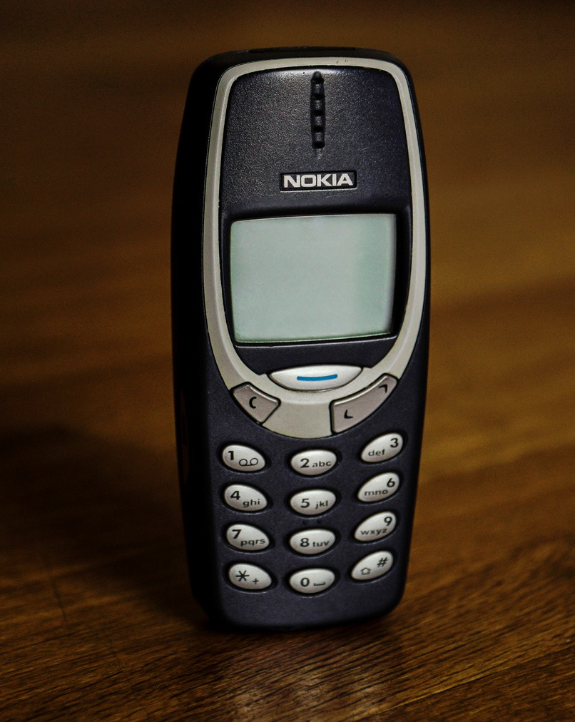

A New, Intelligent Approach
Moving from Reactive to Proactive
The Old Way
One approach to communication with every
patient. No adjustment for age, language, or technical ability or focus on those that need support the most.
The NEW Way
A tool that allows us to identify patients at high risk of non-attendance and target our support to those that need it most. Leveraging cutting edge AI tools and the scale of the Barts Health dataset

Slide 4




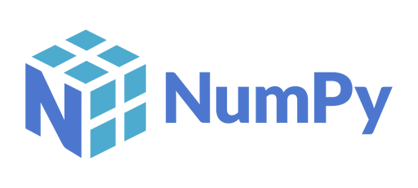





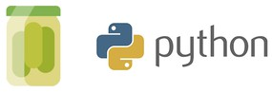

OPEN REPRODUCIBLE SOLUTUON
EXTRACT Transform Train/ test Present
(Other data storage solutions are available )
sqlalchemy
One Hot Encoding Feature engineering
Label encoding String cleaning Data type setting
80/20 split for test and train, Grid search optimization Prediction performance
Internally hosted streamlit application Graphing through plotly and matplotlib
parquet files

Slide 5




HOW IT WORKS
Built by THE NHS, for THE NHS
WHAT HAS IT LEARNT?
Appointment Histories
F1 SCORE OF 0.9
Great at both correctly identifing no-shows and not overpredicting non-attendance.
PREVIOUS APPOINTMENTS
The patients DNA score is the key predictor
of if they are going to attend thier next appointment or not.
DEMOGRAPHICS
SErvice Interations
BOOKING DATE
If the appointment was booked a very long time ago there is a much higher risk that the patient will not attend. The model found that this only applies to follow-ups.
TEST RESULTS
PATHWAY STATUS
If the patient has not yet been treated for thier referred condition then they are much more likely to attend. Indicating the stage of treatment is key
THE MODEL
Trained on 8.2million Barts Health appointments and 160 features of that appointment and patient
Appointment Booking

Slide 6
THE Predictive Non-Attendance Tool
Identify, Implement, Optimise

Slide 7
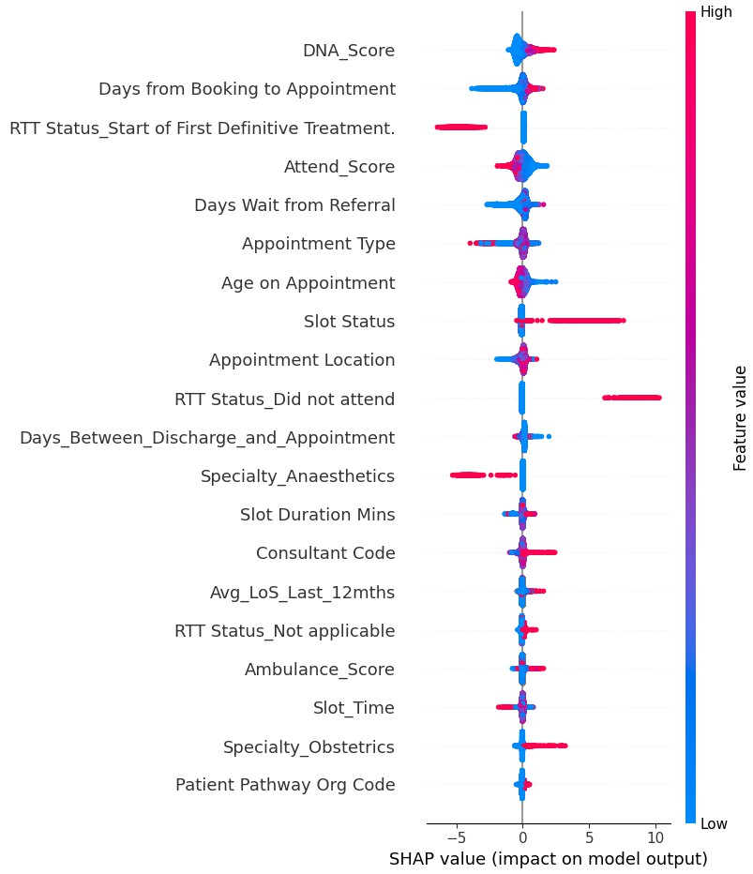
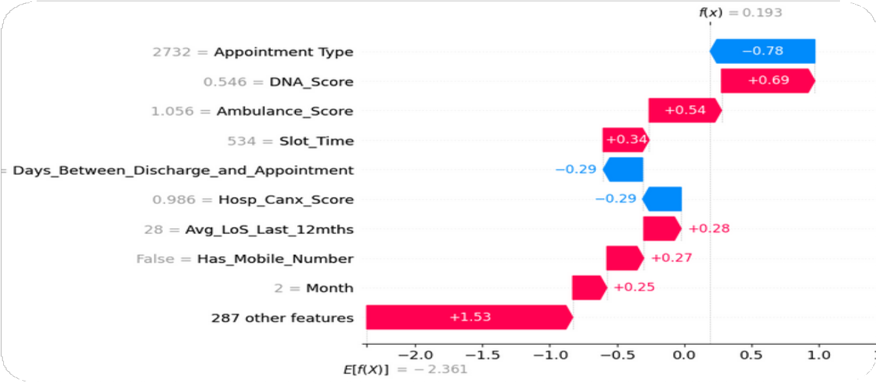
EXPLAINABLE & TRUSTWORTHY
AI
A Transparent Model
We can see why the model makes a prediction. Based on key features of the future appointment. Predictions can be broken down into the elements that formed the forecast. The model will continue to learn as more data is fed in.

Slide 8
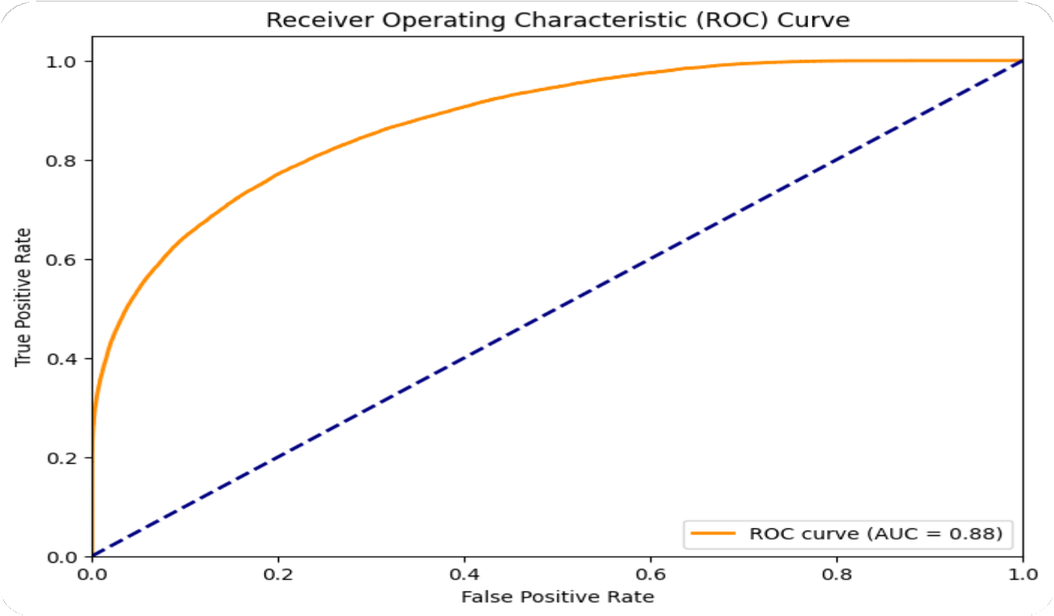
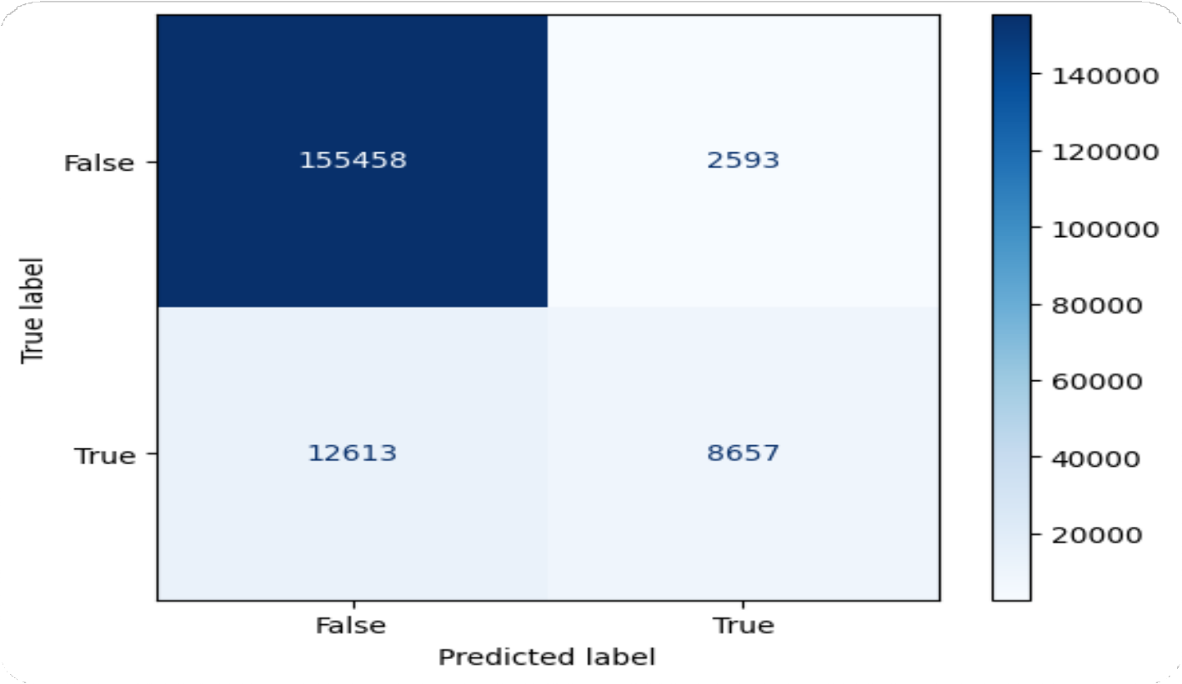
robust & Accurate performance
The model is highly accurate
F-1 Score: 0.9; Balanced Accuracy score: 0.69: AUC score: 0.88. Indicating that you can be confident in its predictions and it very good at identifying patients who will not attend and doesn’t flag lots of patients who will attend.

Slide 9

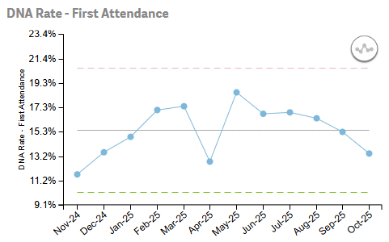
FROM MODEL TO IMPACT
Early results from Pilot Service
Piloted through call lists for Physio first attendances targeted calls for identified high risk patients. Data shows 6 months of decreasing DNA nearing the threshold for a statistical significance. Achieving a 1% decrease in DNA’s would generate ~ 240k of additional income across the Trust.

Slide 10
Open Collaboration
Sharing the model
Clone, Adapt, and deploy
Download the model, adapt it for your Trust and deploy.
github.com/WX-BIU/Outpatient-DNA
Add Features, Test Locally
Does the model adjust for different populations? Does it deliver the same performance for your service?
Build and Refine
Refine the feature selection, feature engineering and help test the pipeline. Add features to the Streamlit application. Share your evaluation results and help improve the solution

Slide 11




Lessons Learned
Explainability
People want to understand the reasons why a forecast has been made and what elements contributed to it. Highlighting that data quality change have a large impact on the forecast.
Share Early
Having a working prototype through Streamlit helped to generate ideas, foster excitement and get real feedback.
Clinical Engagement
Clinical input was essential to ensure that predictions made sense within their service context.
Final Mile
Getting a model into operational use is challenging and getting people to use the tool is more difficult than building it!

Slide 12

THANK YOU
CONTACT
PEter.Andrews@NHS.NEt
Source COde
https://github.com/WX-BIU/ Outpatient-DNAs

